Slide 1

ORANGE
FIBER

Slide 2
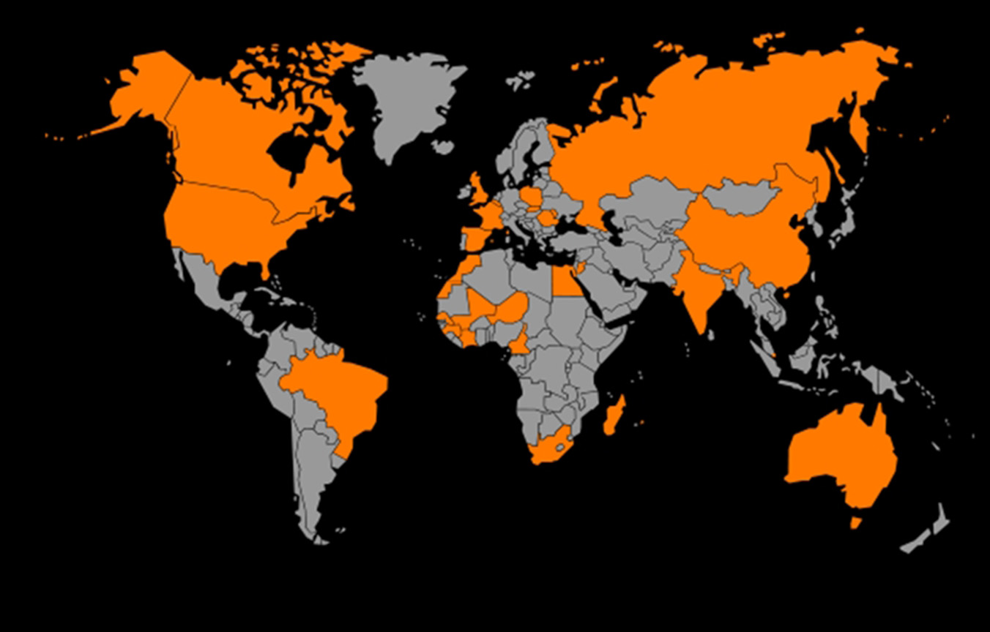

ORANGE
FIBER
CODING ACADEMY BY ORANGE
TASK 1

Slide 3
O U T L I N E S
ORANGE
FIBER
CODING ACADEMY BY ORANGE
RAZAN SALMAN
NEDAL ALTITI
LAITH RASHEED
TASK 1
PROBLEM DEFINITION
PROBLEM STRUCTURE
FEATURES
HYPOTHESIS
RECOMMENDATION

Slide 4

PROBLEM DEFINITION
CODING ACADEMY BY ORANGE
ORANGE
FIBER
TASK 1
O U T L I N E S
PROBLEM DEFINITION
PROBLEM STRUCTURE
FEATURES
HYPOTHESIS
RECOMMENDATION
PROBLEM OF DEFINITION

Slide 5

O U T L I N E S
CODING ACADEMY BY ORANGE
ORANGE
FIBER
TASK 1
PROBLEM DEFINITION
Dataset that includes details about fiber customers, demographics, subscription technical information, and contract type
INITIAL SITUATION
PROBLEM DEFINITION
PROBLEM STRUCTURE
FEATURES
HYPOTHESIS
RECOMMENDATION

Slide 6
CODING ACADEMY BY ORANGE
ORANGE
FIBER
TASK 1
PROBLEM DEFINITION
1. OUR OBJECTIVE
2. BUISSNIS OBJECTIVE
Dataset that includes details about fiber customers, demographics, subscription technical information, and contract type
PROJECT SCOPE/ USE CASE
INITIAL SITUATION
OUR OBJECTIVE
BUISSNES OBJECTIVE
identify customers who are at risk of churning and check their loyalty and satisfaction
REDUCE THE CHURN RATE AND IMPROVING CUSTOMER RETENTION

Slide 7

What is the churn rate?
CODING ACADEMY BY ORANGE
ORANGE
FIBER
TASK 1
PROBLEM DEFINITION
1. OUR OBJECTIVE
2. BUISSNIS OBJECTIVE
Dataset that includes details about fiber customers, demographics, subscription technical information, and contract type
PROJECT SCOPE/ USE CASE
INITIAL SITUATION
OUR OBJECTIVE
BUISSNES OBJECTIVE
identify customers who are at risk of churning and check their loyalty and satisfaction
REDUCE THE CHURN RATE AND IMPROVING CUSTOMER RETENTION

Slide 8
PROBLEM DEFINITION
CODING ACADEMY BY ORANGE
What is the churn rate?
ORANGE
FIBER
TASK 1
“Churn rate is a metric used to measure the rate at which customers or subscribers discontinue using a company's products or services over a given period of time”
1. OUR OBJECTIVE
2. BUISSNIS OBJECTIVE
PROJECT SCOPE/ USE CASE
1- CUSTOMER DIES OR GOES OUT OF BUSINESS.
2- JUST DO NOT ACHIEVE THEIR DESIRED OUTCOME.
OUR OBJECTIVE
BUISSNES OBJECTIVE
identify customers who are at risk of churning and check their loyalty and satisfaction
REDUCE THE CHURN RATE AND IMPROVING CUSTOMER RETENTION
REASONS
Notes:
It is usually expressed as a percentage of the total number of customers or subscribers that were using the service at the beginning of the period. A high churn rate can be an indication of customer dissatisfaction, which can lead to a loss of revenue and market share for the company. Therefore, it is important for companies to identify customers who are at risk of churning and take steps to retain them.

Slide 9
CODING ACADEMY BY ORANGE
What is the churn rate?
ORANGE
FIBER
TASK 1
“Churn rate is a metric used to measure the rate at which customers or subscribers discontinue using a company's products or services over a given period of time”
REASONS
1- CUSTOMER DIES OR GOES OUT OF BUSINESS.
2- JUST DO NOT ACHIEVE THEIR DESIRED OUTCOME.

Slide 10


CODING ACADEMY BY ORANGE
What is the churn rate?
ORANGE
FIBER
TASK 1
“Churn rate is a metric used to measure the rate at which customers or subscribers discontinue using a company's products or services over a given period of time”
SOLUTIONS
CHURN RATE CALCULATION
REASONS
identify customers who are at risk of churning and take steps to retain them.
CHURN RATE CAPTURES THE NUMBER OF PEOPLE WE RETAIN AT THE END OF A TIME PERIOD.
1- CUSTOMER DIES OR GOES OUT OF BUSINESS.
2- JUST DO NOT ACHIEVE THEIR DESIRED OUTCOME.
CHURN RATE = CUSTOMERS AT START OF USAGE INTERVAL – CUSTOMERS AT END OF USAGE INTERVAL
CUSTOMERS AT START OF USAGE INTERVAL

Slide 11
CODING ACADEMY BY ORANGE
What is the churn rate?
ORANGE
FIBER
TASK 1
“Churn rate is a metric used to measure the rate at which customers or subscribers discontinue using a company's products or services over a given period of time”
in general, an annual churn rate of 5% is seen as a reasonable benchmark
SUCCESS CRITERIA
SOLUTIONS
CHURN RATE CALCULATION
identify customers who are at risk of churning and take steps to retain them.
CHURN RATE CAPTURES THE NUMBER OF PEOPLE WE RETAIN AT THE END OF A TIME PERIOD.
CHURN RATE = CUSTOMERS AT START OF USAGE INTERVAL – CUSTOMERS AT END OF USAGE INTERVAL
CUSTOMERS AT START OF USAGE INTERVAL

Slide 12
CODING ACADEMY BY ORANGE
ORANGE
FIBER
TASK 1
PROBLEM DEFINITION
in general, an annual churn rate of 5% is seen as a reasonable benchmark
SUCCESS CRITERIA

Slide 13
CODING ACADEMY BY ORANGE
ORANGE
FIBER
TASK 1
PROBLEM STRUCTURE
in general, an annual churn rate of 5% is seen as a reasonable benchmark
SUCCESS CRITERIA
FRAME THE PROBLEM
GET THE DATA
EDA
MISINTERPRETATION SOME FEATURES
MISSING VALUES
OUTLIERS AND VARIATION
IMBALANCE DATA
CATEGOR-ICAL DATA

Slide 14
CODING ACADEMY BY ORANGE
ORANGE
FIBER
TASK 1
PROBLEM STRUCTURE
“WHAT COULD BE THE KEY ELEMENT OF THE PROBLEM?”
FRAME THE PROBLEM
GET THE DATA
EDA
MISINTERPRETATION SOME FEATURES
MISSING VALUES
OUTLIERS AND VARIATION
IMBALANCE DATA
CATEGOR-ICAL DATA

Slide 15

CODING ACADEMY BY ORANGE
PROBLEM STRUCTURE
ORANGE
FIBER
“WHAT COULD BE THE KEY ELEMENT OF THE PROBLEM?”
TASK 1
FRAME THE PROBLEM
GET THE DATA
EDA
MISINTERPRETATION SOME FEATURES
MISSING VALUES
OUTLIERS AND VARIATION
IMBALANCE DATA
CATEGOR-ICAL DATA
Structured
SEARCH
ASK EXPERTS
CASE STUDIES
Transformation
Non representative
Encoding to convert them to numerical values
2. MAR
2. Modeling
3. MNAR
3- Normalization
2. skewness
Notes:
MISSING AT RANDOM/ MISSING NOT AT RANDOM

Slide 16
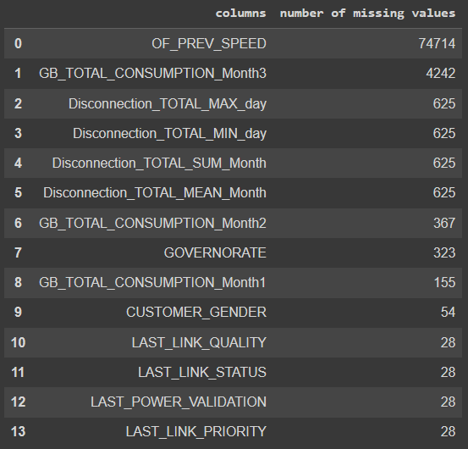
CODING ACADEMY BY ORANGE
PROBLEM STRUCTURE
ORANGE
FIBER
“WHAT COULD BE THE KEY ELEMENT OF THE PROBLEM?”
TASK 1
MISSING VALUES
Methods to handle the missing values
Numerical Variable
1- delete the missing values x
2- using the mean x
3- using the median, better for outlier and skewness
4- iterative imputation
Categorical Variable
1- delete the missing values
2- impute the missing values with most frequent variable
3- iterative imputation
We have 82,467 missing values in total

Slide 17
CODING ACADEMY BY ORANGE
PROBLEM STRUCTURE
ORANGE
FIBER
“WHAT COULD BE THE KEY ELEMENT OF THE PROBLEM?”
TASK 1
MISSING VALUES
Methods to handle the missing values
Numerical Variable
1- delete the missing values x
2- using the mean x
3- using the median, better for outlier and skewness
4- iterative imputation
Categorical Variable
1- delete the missing values
2- impute the missing values with most frequent variable
3- iterative imputation
We have 82,467 missing values in total

Slide 18
CODING ACADEMY BY ORANGE
PROBLEM STRUCTURE
ORANGE
FIBER
“WHAT COULD BE THE KEY ELEMENT OF THE PROBLEM?”
TASK 1
Outliers
Methods to handle the missing values
80 K
70 K
60 K
50 K
40 K
30 K
20 K
10 K
0 K
Numerical Variable
1- delete the missing values x
2- using the mean x
3- using the median, better for outlier and skewness
4- iterative imputation
Categorical Variable
1- delete the missing values
2- impute the missing values with most frequent variable
3- iterative imputation
COUNT OF SPEED
0 50 100 150 200 250 300 350 400 450 500 550 600 650 700 750 800 850 900 950 1000 1050
OF SPEED

Slide 19
CODING ACADEMY BY ORANGE
PROBLEM STRUCTURE
ORANGE
FIBER
“WHAT COULD BE THE KEY ELEMENT OF THE PROBLEM?”
TASK 1
IMBALANCE DATA
CHURNED vs UNCHARNED CUSTOMERS
99.5%
100%
90%
Target 0 : people who Stay with Orange
Target 1 : People who left Orange
80%
70%
60%
Methods to handle the imbalance data
1- Combine oversampling and undersampling and keep in mind to take the sample that is representative to the population
2- Oversampling synthetic Data
3-Use algorithms with weighted average
% of Total Count Of Customers With Orange Months
50%
40%
30%
20%
10%
0.05%
0%
0
1
Target

Slide 20
CODING ACADEMY BY ORANGE
PROBLEM STRUCTURE
ORANGE
FIBER
“WHAT COULD BE THE KEY ELEMENT OF THE PROBLEM?”
TASK 1
Categorical data
Methods to handle categorical data
1- OneHotEncoding, e.g “Gender, Migration Flag”.
2- LabelEncoding, e.g “age group”.
OneHotEncoding
TARGET | F | M
0 | 0 | 1
1 | 1 | 0
LabelEncoding
AGE GROUP | CATEGORICAL | TARGET
CHILD | 1 | 1
TENEEAGER | 2 | 1
ADULT | 3 | 0
SENIOR | 4 | 0
Notes:
Example for onehorencoding,, and labelencoding

Slide 21
CODING ACADEMY BY ORANGE
PROBLEM STRUCTURE
ORANGE
FIBER
“WHAT COULD BE THE KEY ELEMENT OF THE PROBLEM?”
TASK 1
FRAME THE PROBLEM
GET THE DATA
EDA
MISINTERPRETATION SOME FEATURES
MISSING VALUES
OUTLIERS AND VARIATION
IMBALANCE DATA
CATEGOR-ICAL DATA
Structured
SEARCH
ASK EXPERTS
CASE STUDIES
Transformation
Non representative
Encoding to convert them to numerical values
2. MAR
2. Modeling
3. MNAR
3- Normalization
2. skewness
Notes:
MISSING AT RANDOM/ MISSING NOT AT RANDOM

Slide 22
CODING ACADEMY BY ORANGE
PROBLEM STRUCTURE
ORANGE
FIBER
“WHAT COULD BE THE KEY ELEMENT OF THE PROBLEM?”
TASK 1
FRAME THE PROBLEM
GET THE DATA
EDA
MISINTERPRETATION SOME FEATURES
MISSING VALUES
OUTLIERS AND VARIATION
IMBALANCE DATA
CATEGOR-ICAL DATA
DATA GAB

Slide 23
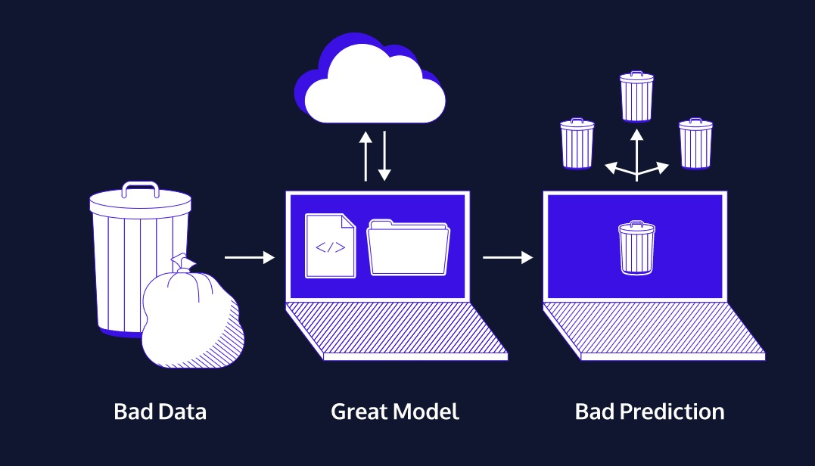
FRAME THE PROBLEM
ORANGE
FIBER
GET THE DATA
EDA
MISINTERPRETATION SOME FEATURES
MISSING VALUES
OUTLIERS AND VARIATION
IMBALANCE DATA
CATEGOR-ICAL DATA
PROBLEM STRUCTURE
“WHAT COULD BE THE KEY ELEMENT OF THE PROBLEM?”
CODING ACADEMY BY ORANGE
DATA GAB
TASK 1
GARBAGE IN, GARBAGE OUT
Notes:
Exploraty data analysis /// frame the problem + get the data + ((((eda + prepare the data (data gap – garp in and out شرح المشاكل ))) + explore different models )VISULAZATION) + model train + evaluation and fine tunning the modelعدم استخدام ال accuracy /combining precision and recall, f1score, area under curve ROC /

Slide 24
PROBLEM STRUCTURE
“WHAT COULD BE THE KEY ELEMENT OF THE PROBLEM?”
CODING ACADEMY BY ORANGE
FRAME THE PROBLEM
ORANGE
FIBER
GET THE DATA
TASK 1
EDA
MISINTERPRETATION SOME FEATURES
MISSING VALUES
OUTLIERS AND VARIATION
IMBALANCE DATA
CATEGOR-ICAL DATA
DATA GAB
VISULIZATION
VISUALIZATION
EXPLORE DIFFERENT MODELS
FINE TUNNING THE MODEL
EVALUATION METRICS
COMBINING PRECISION AND RECALL, F1 SCORE, AREA UNDER CURVE ROC
PRESENT SOLUTION
Notes:
Exploraty data analysis /// frame the problem + get the data + ((((eda + prepare the data (data gap – garp in and out شرح المشاكل ))) + explore different models )VISULAZATION) + model train + evaluation and fine tunning the modelعدم استخدام ال accuracy /combining precision and recall, f1score, area under curve ROC /

Slide 25

MISINTERPRETATION SOME FEATURES
MISSING VALUES
OUTLIERS AND VARIATION
IMBALANCE DATA
CATEGOR-ICAL DATA
PROBLEM STRUCTURE
“WHAT COULD BE THE KEY ELEMENT OF THE PROBLEM?”
CODING ACADEMY BY ORANGE
FRAME THE PROBLEM
ORANGE
FIBER
GET THE DATA
TASK 1
EDA
DATA GAB
VISUALIZATION
EXPLORE DIFFERENT MODELS
FINE TUNNING THE MODEL
EVALUATION METRICS
COMBINING PRECISION AND RECALL, F1 SCORE, AREA UNDER CURVE ROC
PRESENT SOLUTION
DEPLOY THE MODEL
Notes:
Exploraty data analysis /// frame the problem + get the data + ((((eda + prepare the data (data gap – garp in and out شرح المشاكل ))) + explore different models )VISULAZATION) + model train + evaluation and fine tunning the modelعدم استخدام ال accuracy /combining precision and recall, f1score, area under curve ROC /

Slide 26
MISINTERPRETATION SOME FEATURES
MISSING VALUES
OUTLIERS AND VARIATION
IMBALANCE DATA
CATEGOR-ICAL DATA
PROBLEM STRUCTURE
“WHAT COULD BE THE KEY ELEMENT OF THE PROBLEM?”
CODING ACADEMY BY ORANGE
FRAME THE PROBLEM
ORANGE
FIBER
GET THE DATA
TASK 1
EDA
DATA GAP
VISULIZATION
DEPLOY THE MODEL
EXPLORE DIFFERENT MODELS
FINE TUNNING THE MODEL
EVALUATION METRICS
COMBINING PRECISION AND RECALL, F1 SCORE. AREA, UNDER CURVE ROC
PRESENT SOLUTION
Notes:
Exploraty data analysis /// frame the problem + get the data + ((((eda + prepare the data (data gap – garp in and out شرح المشاكل ))) + explore different models )VISULAZATION) + model train + evaluation and fine tunning the modelعدم استخدام ال accuracy /combining precision and recall, f1score, area under curve ROC /

Slide 27

MIGRATION FLAG
DISCONN-ECTION TOTAL MIN/DAY
GP TOTAL CONSUM-PTION/ MONTH 3
DISCONN-ECTION TOTAL SUM/MONTH
CUSTOMER AGE/ MONTHS
GP TOTAL CONSUM-PTION/ MONTH 2
CUSTOMER WITH ORANGE/ MONTHS
GP TOTAL CONSUM-PTION/ MONTH 1
ID
CUSTOMER GENDER
OF SPEED
CODING ACADEMY BY ORANGE
ORANGE
FIBER
TASK 1
FEATURES
LAST POWER VALIDATION
COMMET-MENT
LAST LINK STATUS
DISCONN-ECTION TOTAL MAX/DAY
LAST L INK QUALITY
DISCONN-ECTION TOTAL MEAN/MONTH
COMMETMENT FG
LAST LINK PRIORITY
OF PREV- SPEED
GOVERN-ORATE
TARGET
Notes:
NEED A GOOD TRANSITION AND DESIGN

Slide 28
CODING ACADEMY BY ORANGE
GP TOTAL CONSUMPTION MONTH 3
DATASET
MIGRATION FLAG
DISCONNECTION TOTAL MIN/DAY
ORANGE
FIBER
GOVERNORATE
TASK 1
LAST POWER VALIDATION
CUSTOMER AGE/ MONTHS
GP TOTAL CONSUMPTION
MONTH 2
DISCONNECTION TOTAL SUM/MONTH
CUSTOMER GENDER
COMMETMENT
TARGET
0 churned
1 unchurned
OF SPEED
LAST LINK PRIORITY
GP TOTAL CONSUMPTION MONTH 1
OF PREV- SPEED
DISCONNECTION TOTAL MEAN/MONTH
ID
DISCONNECTION TOTAL MAX/DAY
COMMETMENT FG
LAST LINK QUALITY
CUSTOMER WITH ORANGE/ MONTHS
LAST LINK STATUS
Notes:
ADD ID

Slide 29

CODING ACADEMY BY ORANGE
GP TOTAL CONSUMPTION MONTH 3
DATASET
MIGRATION FLAG
DISCONNECTION TOTAL MIN/DAY
ORANGE
FIBER
GOVERNORATE
TASK 1
LAST POWER VALIDATION
CUSTOMER AGE/ MONTHS
GP TOTAL CONSUMPTION
MONTH 2
DISCONNECTION TOTAL SUM/MONTH
CUSTOMER GENDER
COMMETMENT
TARGET
0 churned
1 unchurned
OF SPEED
LAST LINK PRIORITY
ID
GP TOTAL CONSUMPTION MONTH 1
OF PREV- SPEED
DISCONNECTION TOTAL MEAN/MONTH
ID customers/ Unusfel feature
DISCONNECTION TOTAL MAX/DAY
COMMETMENT FG
LAST LINK QUALITY
CUSTOMER WITH ORANGE/ MONTHS
LAST LINK STATUS
Notes:
ADD ID

Slide 30
CODING ACADEMY BY ORANGE
GP TOTAL CONSUMPTION MONTH 3
DATASET
MIGRATION FLAG
DISCONNECTION TOTAL MIN/DAY
ORANGE
FIBER
GOVERNORATE
TASK 1
LAST POWER VALIDATION
CUSTOMER AGE/ MONTHS
GP TOTAL CONSUMPTION
MONTH 2
DISCONNECTION TOTAL SUM/MONTH
CUSTOMER GENDER
COMMETMENT
TARGET
0 churned
1 unchurned
OF SPEED
LAST LINK PRIORITY
GP TOTAL CONSUMPTION MONTH 1
Fiber customers in terms of the Cities in Jordan
OF PREV- SPEED
DISCONNECTION TOTAL MEAN/MONTH
ID
DISCONNECTION TOTAL MAX/DAY
COMMETMENT FG
LAST LINK QUALITY
CUSTOMER WITH ORANGE/ MONTHS
LAST LINK STATUS

Slide 31
CODING ACADEMY BY ORANGE
GP TOTAL CONSUMPTION MONTH 3
DATASET
MIGRATION FLAG
DISCONNECTION TOTAL MIN/DAY
ORANGE
FIBER
GOVERNORATE
TASK 1
30 k
28 k
26 k
24 k
22 k
20 k
K
16 k
14 k
12 k
10 k
8 k
6 k
4 k
2 k
0 k
CUSTOMER AGE/ MONTHS
LAST POWER VALIDATION
GP TOTAL CONSUMPTION
MONTH 2
DISCONNECTION TOTAL SUM/MONTH
CUSTOMER GENDER
COMMETMENT
TARGET
0 churned
1 unchurned
(Customer Age) ranged from 1month to 1400 months
OF SPEED
LAST LINK PRIORITY
CUSTOMER WITH ORANGE/ MONTHS
COUNT OF CUSTOMERS AGE MONTHS
GP TOTAL CONSUMPTION MONTH 1
OF PREV- SPEED
DISCONNECTION TOTAL MEAN/MONTH
ID
DISCONNECTION TOTAL MAX/DAY
COMMETMENT FG
Customer duration with Orange (Loyalty)
LAST LINK QUALITY
LAST LINK STATUS
-500 0 100 200 300 400 500 600 700 800 900 1000
CUSTOMER AGE MONTHS

Slide 32
CODING ACADEMY BY ORANGE
GP TOTAL CONSUMPTION MONTH 3
DATASET
MIGRATION FLAG
DISCONNECTION TOTAL MIN/DAY
ORANGE
FIBER
GOVERNORATE
TASK 1
30 k
28 k
26 k
24 k
22 k
20 k
K
16 k
14 k
12 k
10 k
8 k
6 k
4 k
2 k
0 k
CUSTOMER AGE/ MONTHS
LAST POWER VALIDATION
GP TOTAL CONSUMPTION
MONTH 2
DISCONNECTION TOTAL SUM/MONTH
CUSTOMER GENDER
COMMETMENT
TARGET
0 churned
1 unchurned
(Customer Age) ranged from 1month to 1400 months
OF SPEED
COUNT OF CUSTOMERS AGE MONTHS
LAST LINK PRIORITY
GP TOTAL CONSUMPTION MONTH 1
OF PREV- SPEED
DISCONNECTION TOTAL MEAN/MONTH
ID
DISCONNECTION TOTAL MAX/DAY
COMMETMENT FG
LAST LINK QUALITY
CUSTOMER WITH ORANGE/ MONTHS
LAST LINK STATUS
-500 0 100 200 300 400 500 600 700 800 900 1000
CUSTOMER AGE MONTHS
Convert it to years and Categorize “ Customer Age “ to Age group.
Customer age group in “years”
75K
70K
65K
55K
50K
45K
40K
35K
30K
25K
20K
15K
10K
5K
0K
Child Under 18
Teenager 19-25
Adult 25-60
Seniors Above 60
74.05%
COUNT OF F1
18.99%
6.87%
0.09%
ADULT SENIOR TEENAGER CHILD
AGE GROUP

Slide 33
30 k
28 k
26 k
24 k
22 k
20 k
K
16 k
14 k
12 k
10 k
8 k
6 k
4 k
2 k
0 k
COUNT OF CUSTOMERS AGE MONTHS
CUSTOMER AGE/ MONTHS
(Customer Age) ranged from 1month to 88 years
-500 0 100 200 300 400 500 600 700 800 900 1000
CUSTOMER AGE MONTHS
CODING ACADEMY BY ORANGE
GP TOTAL CONSUMPTION MONTH 3
DATASET
MIGRATION FLAG
DISCONNECTION TOTAL MIN/DAY
ORANGE
FIBER
GOVERNORATE
TASK 1
Convert it to years and Categorize “ Customer Age “ to Age group.
LAST POWER VALIDATION
Customer age group in “years”
75K
70K
65K
55K
50K
45K
40K
35K
30K
25K
20K
15K
10K
5K
0K
Child Under 18
Teenager 19-25
Adult 25-60
Seniors Above 60
74.05%
GP TOTAL CONSUMPTION
MONTH 2
DISCONNECTION TOTAL SUM/MONTH
CUSTOMER GENDER
COMMETMENT
TARGET
0 churned
1 unchurned
OF SPEED
LAST LINK PRIORITY
COUNT OF F1
GP TOTAL CONSUMPTION MONTH 1
OF PREV- SPEED
DISCONNECTION TOTAL MEAN/MONTH
ID
18.99%
DISCONNECTION TOTAL MAX/DAY
COMMETMENT FG
LAST LINK QUALITY
CUSTOMER WITH ORANGE/ MONTHS
6.87%
LAST LINK STATUS
0.09%
ADULT SENIOR TEENAGER CHILD
AGE GROUP

Slide 34
CUSTOMER AGE/ MONTHS
CODING ACADEMY BY ORANGE
GP TOTAL CONSUMPTION MONTH 3
DATASET
MIGRATION FLAG
DISCONNECTION TOTAL MIN/DAY
ORANGE
FIBER
GOVERNORATE
TASK 1
Categorize “ Customer Age “ to Age group and convert it to years
LAST POWER VALIDATION
Customer age group in “years”
75K
70K
65K
55K
50K
45K
40K
35K
30K
25K
20K
15K
10K
5K
0K
Child Under 18
Teenager 19-25
Adult 25-60
Seniors Above 60
74.05%
GP TOTAL CONSUMPTION
MONTH 2
DISCONNECTION TOTAL SUM/MONTH
CUSTOMER GENDER
COMMETMENT
TARGET
0 unchurned
1 churned
OF SPEED
LAST LINK PRIORITY
GP TOTAL CONSUMPTION MONTH 1
COUNT OF F1
OF PREV- SPEED
DISCONNECTION TOTAL MEAN/MONTH
ID
18.99%
DISCONNECTION TOTAL MAX/DAY
COMMETMENT FG
LAST LINK QUALITY
CUSTOMER WITH ORANGE/ MONTHS
6.87%
LAST LINK STATUS
0.09%
ADULT SENIOR TEENAGER CHILD
AGE GROUP

Slide 35
CODING ACADEMY BY ORANGE
GP TOTAL CONSUMPTION MONTH 3
DATASET
MIGRATION FLAG
DISCONNECTION TOTAL MIN/DAY
ORANGE
FIBER
GOVERNORATE
TASK 1
LAST POWER VALIDATION
Customer age group in “years”
GP TOTAL CONSUMPTION
MONTH 2
DISCONNECTION TOTAL SUM/MONTH
CUSTOMER GENDER
COMMETMENT
TARGET
0 unchurned
1 churned
OF SPEED
LAST LINK PRIORITY
GP TOTAL CONSUMPTION MONTH 1
OF PREV- SPEED
Males, Females, unknown and Null
DISCONNECTION TOTAL MEAN/MONTH
ID
DISCONNECTION TOTAL MAX/DAY
COMMETMENT FG
LAST LINK QUALITY
CUSTOMER WITH ORANGE/ MONTHS
LAST LINK STATUS

Slide 36
CODING ACADEMY BY ORANGE
GP TOTAL CONSUMPTION MONTH 3
DATASET
MIGRATION FLAG
DISCONNECTION TOTAL MIN/DAY
COMMETMENT
ORANGE
FIBER
GOVERNORATE
TASK 1
LAST POWER VALIDATION
Customer age group in “years”
GP TOTAL CONSUMPTION
MONTH 2
DISCONNECTION TOTAL SUM/MONTH
CUSTOMER GENDER
Contract Period Type (12,24, & 36) months
TARGET
0 unchurned
1 churned
OF SPEED
COMMETMENT FG
LAST LINK PRIORITY
GP TOTAL CONSUMPTION MONTH 1
OF PREV- SPEED
DISCONNECTION TOTAL MEAN/MONTH
ID
DISCONNECTION TOTAL MAX/DAY
it indicates customer obligation in terms of contract type
LAST LINK QUALITY
CUSTOMER WITH ORANGE/ MONTHS
LAST LINK STATUS

Slide 37
CODING ACADEMY BY ORANGE
GP TOTAL CONSUMPTION MONTH 3
DATASET
MIGRATION FLAG
DISCONNECTION TOTAL MIN/DAY
ORANGE
FIBER
GOVERNORATE
TASK 1
LAST POWER VALIDATION
CUSTOMER AGE/ MONTHS
OF SPEED
GP TOTAL CONSUMPTION
MONTH 2
DISCONNECTION TOTAL SUM/MONTH
CUSTOMER GENDER
COMMETMENT
TARGET
0 unchurned
1 churned
Optical Fiber Speed
LAST LINK PRIORITY
GP TOTAL CONSUMPTION MONTH 1
OF PREV- SPEED
DISCONNECTION TOTAL MEAN/MONTH
ID
DISCONNECTION TOTAL MAX/DAY
COMMETMENT FG
Optical Fiber Previous Speed, 70% of the data are missing
Previous Optical Fiber Speed
LAST LINK QUALITY
CUSTOMER WITH ORANGE/ MONTHS
LAST LINK STATUS

Slide 38
CODING ACADEMY BY ORANGE
GP TOTAL CONSUMPTION MONTH 3
DATASET
MIGRATION FLAG
DISCONNECTION TOTAL MIN/DAY
ORANGE
FIBER
GOVERNORATE
TASK 1
LAST POWER VALIDATION
Customer age group in “years”
GP TOTAL CONSUMPTION
MONTH 2
It represents the customer upgrade to a higher contract period type
DISCONNECTION TOTAL SUM/MONTH
CUSTOMER GENDER
COMMETMENT
TARGET
0 unchurned
1 churned
OF SPEED
LAST LINK PRIORITY
GP TOTAL CONSUMPTION MONTH 1
OF PREV- SPEED
DISCONNECTION TOTAL MEAN/MONTH
ID
DISCONNECTION TOTAL MAX/DAY
COMMETMENT FG
LAST LINK QUALITY
CUSTOMER WITH ORANGE/ MONTHS
LAST LINK STATUS

Slide 39
CODING ACADEMY BY ORANGE
GP TOTAL CONSUMPTION MONTH 3
DATASET
MIGRATION FLAG
LAST POWER VALIDATION
DISCONNECTION TOTAL MIN/DAY
ORANGE
FIBER
GOVERNORATE
TASK 1
Customer age group in “years”
GP TOTAL CONSUMPTION
MONTH 2
DISCONNECTION TOTAL SUM/MONTH
There is no relationship with other features or the target
CUSTOMER GENDER
COMMETMENT
TARGET
0 unchurned
1 churned
OF SPEED
LAST LINK PRIORITY
GP TOTAL CONSUMPTION MONTH 1
LAST LINK QUALITY
OF PREV- SPEED
LAST LINK STATUS
DISCONNECTION TOTAL MEAN/MONTH
COMMETMENT FG
DISCONNECTION TOTAL MAX/DAY
There is no relationship with other features or the target
There is no relationship with other features or the target
CUSTOMER WITH ORANGE/ MONTHS
There is no relationship with other features or the target

Slide 40
(AVERAGE)
GP TOTAL CONSUMPTION
CODING ACADEMY BY ORANGE
GP TOTAL CONSUMPTION MONTH 3
DATASET
MIGRATION FLAG
DISCONNECTION TOTAL MIN/DAY
ORANGE
FIBER
GOVERNORATE
TASK 1
LAST POWER VALIDATION
Customer age group in “years”
GP TOTAL CONSUMPTION
MONTH 2
DISCONNECTION TOTAL SUM/MONTH
CUSTOMER GENDER
COMMETMENT
TARGET
0 churned
1 unchurned
OF SPEED
LAST LINK PRIORITY
GP TOTAL CONSUMPTION MONTH 1
OF PREV- SPEED
DISCONNECTION TOTAL MEAN/MONTH
ID
DISCONNECTION TOTAL MAX/DAY
COMMETMENT FG
LAST LINK QUALITY
CUSTOMER WITH ORANGE/ MONTHS
LAST LINK STATUS

Slide 41
CODING ACADEMY BY ORANGE
DATASET
MIGRATION FLAG
DISCONNECTION TOTAL MIN/DAY
ORANGE
FIBER
(AVERAGE)
GP TOTAL CONSUMPTION
GP TOTAL CONSUMPTION MONTH 1
GOVERNORATE
GP TOTAL CONSUMPTION
MONTH 2
TASK 1
GP TOTAL CONSUMPTION MONTH 3
LAST POWER VALIDATION
Customer age group in “years”
DISCONNECTION TOTAL SUM/MONTH
CUSTOMER GENDER
COMMETMENT
TARGET
0 unchurned
1 churned
OF SPEED
LAST LINK PRIORITY
OF PREV- SPEED
DISCONNECTION TOTAL MEAN/MONTH
ID
DISCONNECTION TOTAL MAX/DAY
COMMETMENT FG
LAST LINK QUALITY
CUSTOMER WITH ORANGE/ MONTHS
LAST LINK STATUS

Slide 42
GP TOTAL CONSUMPTION MONTH 1
GP TOTAL CONSUMPTION MONTH 3
GP TOTAL CONSUMPTION
MONTH 2
CODING ACADEMY BY ORANGE
DATASET
(AVERAGE)
GP TOTAL CONSUMPTION
MIGRATION FLAG
DISCONNECTION TOTAL MIN/DAY
ORANGE
FIBER
GOVERNORATE
TASK 1
LAST POWER VALIDATION
Customer age group in “years”
DISCONNECTION TOTAL SUM/MONTH
COMMETMENT
CUSTOMER GENDER
TARGET
0 unchurned
1 churned
OF SPEED
LAST LINK PRIORITY
OF PREV- SPEED
DISCONNECTION TOTAL MEAN/MONTH
ID
DISCONNECTION TOTAL MAX/DAY
COMMETMENT FG
LAST LINK QUALITY
CUSTOMER WITH ORANGE/ MONTHS
LAST LINK STATUS

Slide 43
GP TOTAL CONSUMPTION MONTH 1
GP TOTAL CONSUMPTION MONTH 3
GP TOTAL CONSUMPTION
MONTH 2
CODING ACADEMY BY ORANGE
DATASET
(AVERAGE)
GP TOTAL CONSUMPTION
MIGRATION FLAG
DISCONNECTION TOTAL MIN/DAY
ORANGE
FIBER
GOVERNORATE
TASK 1
LAST POWER VALIDATION
Customer age group in “years”
DISCONNECTION TOTAL SUM/MONTH
COMMETMENT
CUSTOMER GENDER
TARGET
0 unchurned
1 churned
OF SPEED
LAST LINK PRIORITY
Irrelevant features
OF PREV- SPEED
DISCONNECTION TOTAL MAX/DAY
DISCONNECTION TOTAL MEAN/MONTH
ID
COMMETMENT FG
LAST LINK QUALITY
CUSTOMER WITH ORANGE/ MONTHS
LAST LINK STATUS

Slide 44
GP TOTAL CONSUMPTION MONTH 1
GP TOTAL CONSUMPTION MONTH 3
GP TOTAL CONSUMPTION
MONTH 2
CODING ACADEMY BY ORANGE
DATASET
MIGRATION FLAG
(AVERAGE)
GP TOTAL CONSUMPTION
DISCONNECTION TOTAL MIN/DAY
ORANGE
FIBER
GOVERNORATE
TASK 1
LAST POWER VALIDATION
Customer age group in “years”
DISCONNECTION TOTAL SUM/MONTH
Irrelevant feature
COMMETMENT
CUSTOMER GENDER
TARGET
0 unchurned
1 churned
DISCONNECTION TOTAL MEAN/MONTH
OF SPEED
LAST LINK PRIORITY
OF PREV- SPEED
ID
Average disconnection Per Month
COMMETMENT FG
DISCONNECTION TOTAL MAX/DAY
LAST LINK QUALITY
CUSTOMER WITH ORANGE/ MONTHS
LAST LINK STATUS

Slide 45
CODING ACADEMY BY ORANGE
DATASET
(AVERAGE)
GP TOTAL CONSUMPTION
MIGRATION FLAG
DISCONNECTION TOTAL MIN/DAY
ORANGE
FIBER
GOVERNORATE
TARGET
0 unchurned
1 churned
TASK 1
LAST POWER VALIDATION
Customer age group in “years”
DISCONNECTION TOTAL SUM/MONTH
COMMETMENT
CUSTOMER GENDER
OF SPEED
LAST LINK PRIORITY
OF PREV- SPEED
DISCONNECTION TOTAL MEAN/MONTH
ID
DISCONNECTION TOTAL MAX/DAY
COMMETMENT FG
LAST LINK QUALITY
CUSTOMER WITH ORANGE/ MONTHS
LAST LINK STATUS

Slide 46
MIGRATION FLAG
DISCONN-ECTION TOTAL MIN/DAY
GP TOTAL CONSUM-PTION/ MONTH 3
DISCONN-ECTION TOTAL SUM/MONTH
CUSTOMER AGE/ MONTHS
GP TOTAL CONSUM-PTION/ MONTH 2
CUSTOMER WITH ORANGE/ MONTHS
GP TOTAL CONSUM-PTION/ MONTH 1
CUSTOMER GENDER
OF SPEED
CODING ACADEMY BY ORANGE
ORANGE
FIBER
TASK 1
HYPOTHESIS
LAST POWER VALIDATION
COMMET-MENT
LAST LINK STATUS
DISCONN-ECTION TOTAL MAX/DAY
LAST L INK QUALITY
DISCONN-ECTION TOTAL MEAN/MONTH
COMMETMENT FG
LAST LINK PRIORITY
OF PREV- SPEED
GOVERN-ORATE
TARGET

Slide 47
CODING ACADEMY BY ORANGE
1
ORANGE
FIBER
TASK 1
320
HYPOTHESIS
300
280
Optical Fiber Speed for CHURNED CUSTOMERS
260
240
220
200
The lower the OF-SPEED, the higher a customer being churned
180
% of Total Count Of Customers With Orange Months
160
140
120
100
80
60
CORRECT
40
20
0
60
200
100
30
400
1000
300
120
OF SPEED

Slide 48
CODING ACADEMY BY ORANGE
2
ORANGE
FIBER
TASK 1
HYPOTHESIS
100%
90%
The probability of a male customer to be churned is higher than the probability of a female customer to be churned
80%
78.39%
78.14%
70%
60%
% of Total Count Of Customers With Orange Months
50%
40%
30%
21.86%
21.61%
20%
10%
0%
WRONG
Male
Female
Male
Female
CHURNED/ TARGET 1
UNCHURNED/ TARGET 0

Slide 49
CODING ACADEMY BY ORANGE
3
ORANGE
FIBER
TASK 1
HYPOTHESIS
Churned Customers Who Either Upgraded Their Contract Or Not
n: did not upgrade
y: upgraded
Customers who don’t perform migration flag (n), have a higher probability to being churned
Migration Flag: The customers who upgraded their contract
CORRECT

Slide 50
CODING ACADEMY BY ORANGE
4
ORANGE
FIBER
TASK 1
HYPOTHESIS
Churned Customers Who Either Renewed Their Contracts Or Not
100%
90%
Customers who don’t commit with their contract period are most likely to being churned more than the customers who commit with their contract period
Renewed their contract (1)
80%
78.97%
They did not renew their contract (0)
70%
60%
% of Total Count Of Customers With Orange Months
50%
40%
30%
21.03%
20%
10%
CORRECT
0%
CHURNED CUSTOMERS (who left Orange)

Slide 51
CODING ACADEMY BY ORANGE
5
ORANGE
FIBER
TASK 1
320
320
HYPOTHESIS
300
280
Churned Customers In Jordan
260
240
220
200
Higher churned customers are from West Amman
180
166
% of Total Count Of Customers With Orange Months
160
140
120
100
80
60
WE CAN NOT PROVE IT
40
20
16
10
7
2
2
0
West Amman
East Amman
Irbid
Zarqa
Balqa
Madaba
Aqaba
Governorate

Slide 52
CODING ACADEMY BY ORANGE
6
ORANGE
FIBER
TASK 1
HYPOTHESIS
Churned Customers vs contract type
100%
94.46%
90%
Customers with 24 months contract type are having higher probability to churn
80%
70%
60%
% of Total Count Of Customers With Orange Months
50%
40%
30%
20%
10%
3.06%
CORRECT
0%
2.49%
24
12
36
Contract Type

Slide 53
CODING ACADEMY BY ORANGE
7
ORANGE
FIBER
TASK 1
HYPOTHESIS
180
178
Churned Customers With Respect To Their Month Consumption
160
150
140
The higher consumption leading lower customers to churn
120
104
100
% of Total Count Of Customers With Orange Months
80
55
60
40
CORRECT
14
20
6
5
4
4
1
1
1
0
0
200
400
600
800
1000
1200
1400
1600
1800
2000
2200
2400
2600
GB Total Mean Consumption

Slide 54
CODING ACADEMY BY ORANGE
8
ORANGE
FIBER
TASK 1
HYPOTHESIS
110
104
Most Customers tend to churn when passing the end of the contract period to avoid penalties and especially for contracts with 24 months because it has best offers and price
100
90
80
70
60
58
50
47
% of Total Count Of Customers With Orange Months
40
30
26
28
20
20
20
21
17
15
17
10
13
13
10
6
6
5
3
5
6
3
5
3
3
4
3
3
5
2
1
1
1
1
2
1
1
2
2
2
2
2
0
0 2 4 6 8 10 12 14 16 18 20 22 24 26 28 30 32 34 36 38 40 42 44 46 48 50 52
Customer with orange/ Months

Slide 55
CODING ACADEMY BY ORANGE
8
ORANGE
FIBER
TASK 1
HYPOTHESIS
110
104
100
Most Customers tend to churn when passing the end of the contract period to avoid penalties and especially for contracts with 24 months because it has best offers and price
90
80
70
60
58
50
47
% of Total Count Of Customers With Orange Months
40
30
26
28
20
20
20
21
17
15
17
10
13
13
10
6
6
5
3
5
6
3
5
3
3
4
3
3
5
2
1
1
1
1
2
1
1
2
2
2
2
2
0
0 2 4 6 8 10 12 14 16 18 20 22 24 26 28 30 32 34 36 38 40 42 44 46 48 50 52
Customer with orange/ Months
CORRECT

Slide 56
CODING ACADEMY BY ORANGE
8
ORANGE
FIBER
TASK 1
HYPOTHESIS
110
Most Customers tend to churn when passing the end of the contract period to avoid penalties and especially for contracts with 24 months because it has best offers and price
104
100
90
80
70
CORRECT
60
58
50
47
% of Total Count Of Customers With Orange Months
40
30
26
28
20
20
20
21
17
15
17
10
13
13
10
6
6
5
3
5
6
3
5
3
3
4
3
3
5
2
1
1
1
1
2
1
1
2
2
2
2
2
0
0 2 4 6 8 10 12 14 16 18 20 22 24 26 28 30 32 34 36 38 40 42 44 46 48 50 52
Customer with orange/ Months

Slide 57
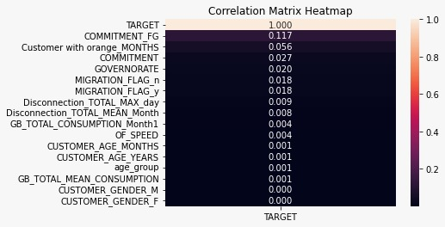
CORELATION MATRIX HEATMAP
CODING ACADEMY BY ORANGE
9
ORANGE
FIBER
TASK 1
HYPOTHESIS
75.91%
Churned Customers age group
400
350
300
250
200
150
100
50
0
Teenager 19-25
Adult 25-60
Seniors Above 60
Adults are the “age group” that churned the most
COUNT OF CUSTOMERS WITH ORANGE BY MONTHS
18.36%
CORRECT
5.74%
ADULT SENIOR TEENAGER
AGE GROUP

Slide 58
Future work
CODING ACADEMY BY ORANGE
ORANGE
FIBER
TASK 1
CORELATION MATRIX HEATMAP

Slide 59
CODING ACADEMY BY ORANGE
ORANGE
FIBER
TASK 1
Future work
1- track down who participated in the data collection and who made the data.
2-collecting more features for our customers
time-based features to capture the patterns and trends in customer behavior over time.
education level, and occupation could provide insights into which customer groups are more likely to churn.
customer service interactions, such as the number of complaints or inquiries, can provide insights into customer satisfaction with the service and identify areas for improvement.
- whether a customer has a spouse or not
3- Incorporate unstructured data such as social media or customer service transcripts that can provide insights into customer behavior and attitudes.
CORELATION MATRIX HEATMAP
Notes:
add time-based features to capture the patterns and trends in customer behavior over time. Get more Features about customers, such as: if the customer has a spouse or not
- add education level, and occupation could provide insights into which customer groups are more likely to churn.
-customer service interactions, such as the number of complaints or inquiries, can provide insights into customer satisfaction with the service and identify areas for improvement.
whether a customer has a spouse or not

Slide 60
CODING ACADEMY BY ORANGE
ORANGE
FIBER
TASK 1
RECOMMENDATION
Ensuring the Supply Chain & Technical Departments are providing a high of-speed all the time, and continuous check for any technical issue could lead to disconnection, because these two are the main factors could lead a customer to churn
Offering attractive deals to customers before the end of their contract is a proactive way to prevent churn
it's important to note that churn rate is not the only metric that companies should consider when evaluating customer satisfaction and loyalty. Other factors such as customer engagement, customer lifetime value, and customer referral rates should also be taken into account
accurate measurement of churn rate requires careful consideration of the time interval and definition of churn, as well as the data quality and business context.

